Slide 1
Pop culture in medieval islam
The Safavids and Coffee

Slide 2
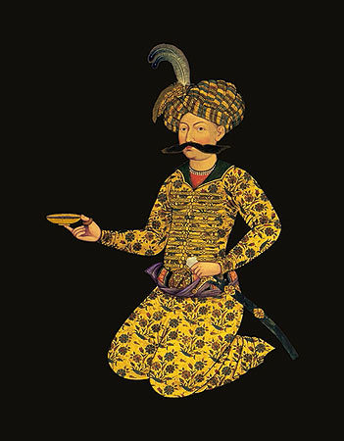
Safavids
1501-1722
Founded by Shah Isma’il (r. 1501-1524), convert to Imami Shi’ism
Built on dissolution of Timurid control and unifies several regions
Centralized bureaucracy and official Imami theology

Slide 3
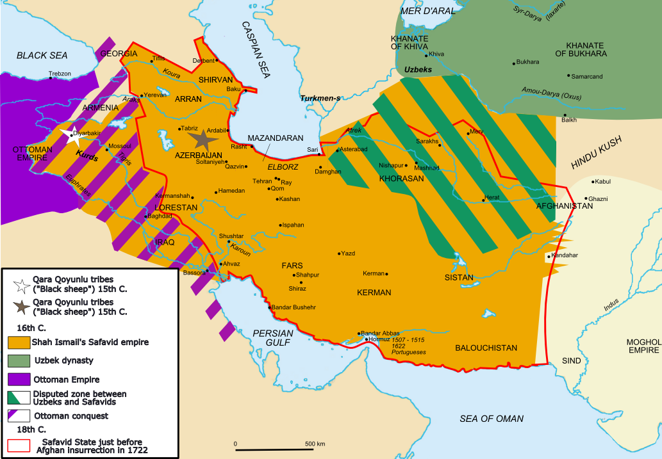

Slide 4
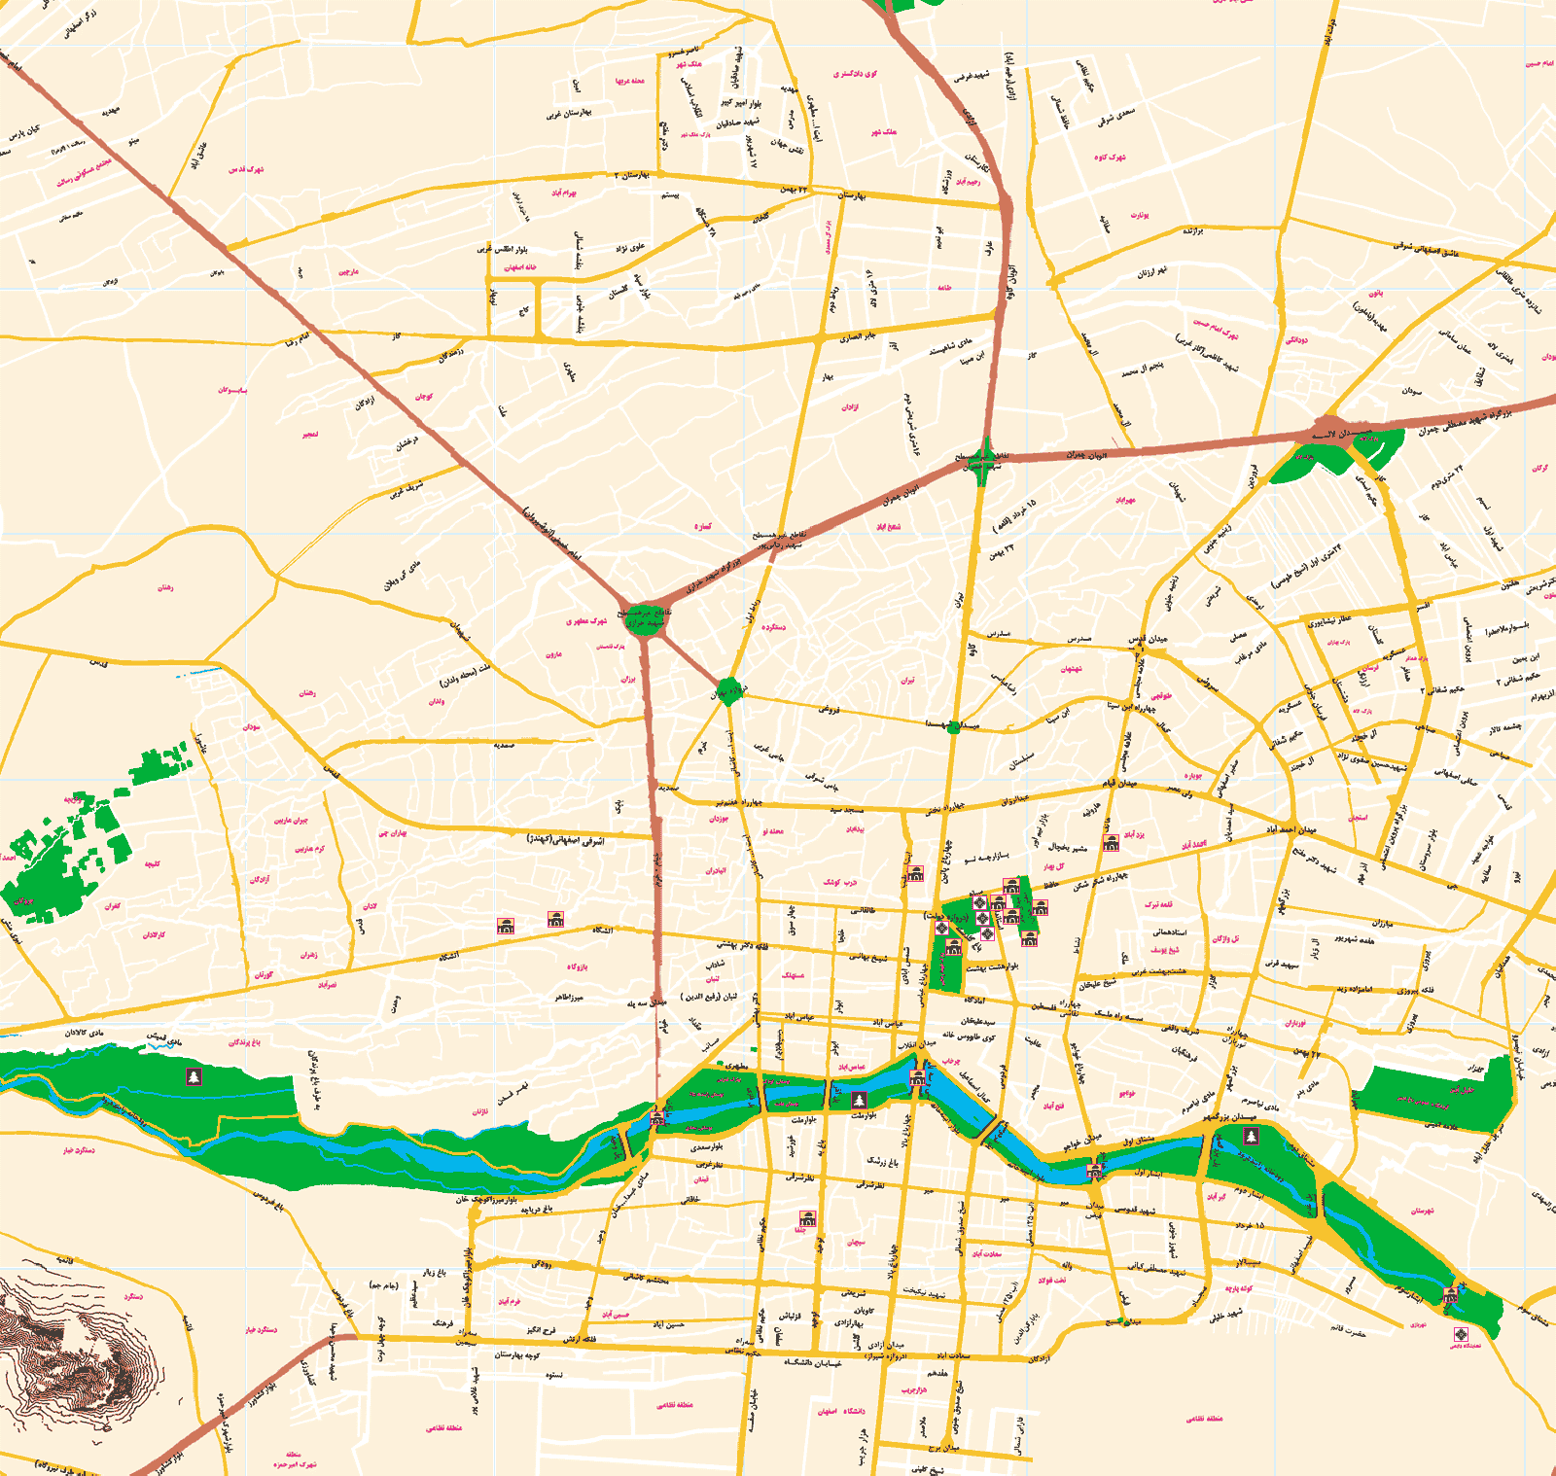

Slide 5
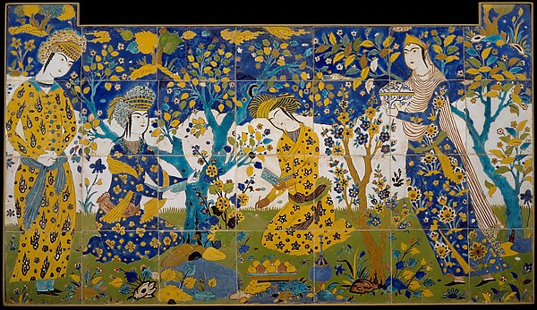
Tile panel, 17th c. Isfahan, met museum

Slide 6
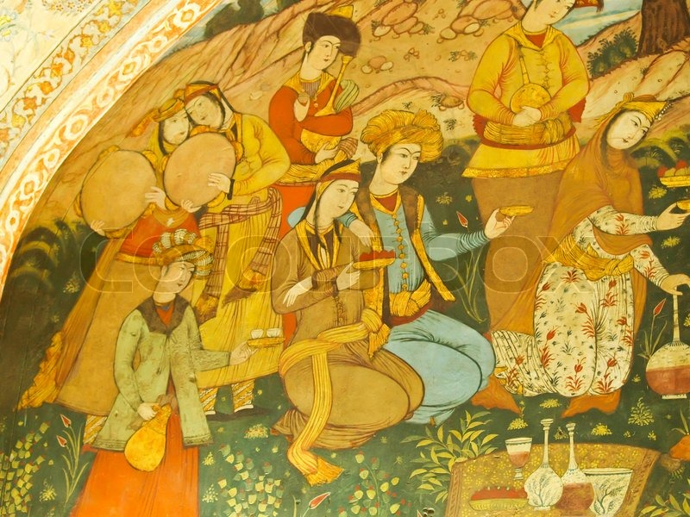
Mural in chehel sultan built by ‘Abbas II (1652-1666)

Slide 7
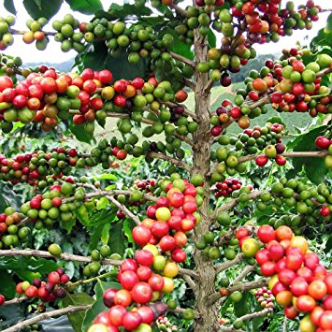
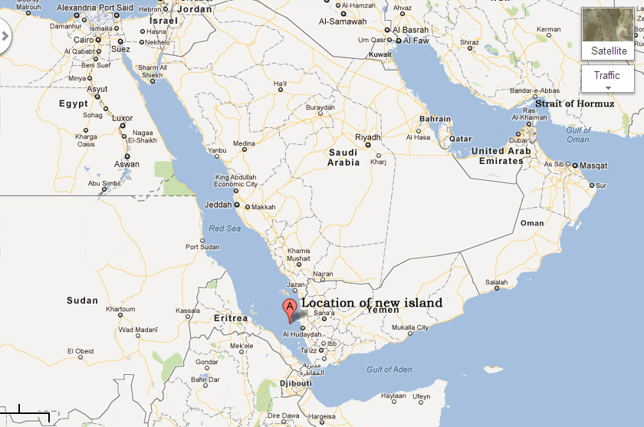
coffee
Cultivated in Yemen and Ethiopia
Globalized consumption in 16th c starting in Cairo and Istanbul
Spreads by 1600 to Iran and Iraq. Introduced via pilgrimage.
https://thegrownetwork.com/grow-coffee-plant/

Slide 8
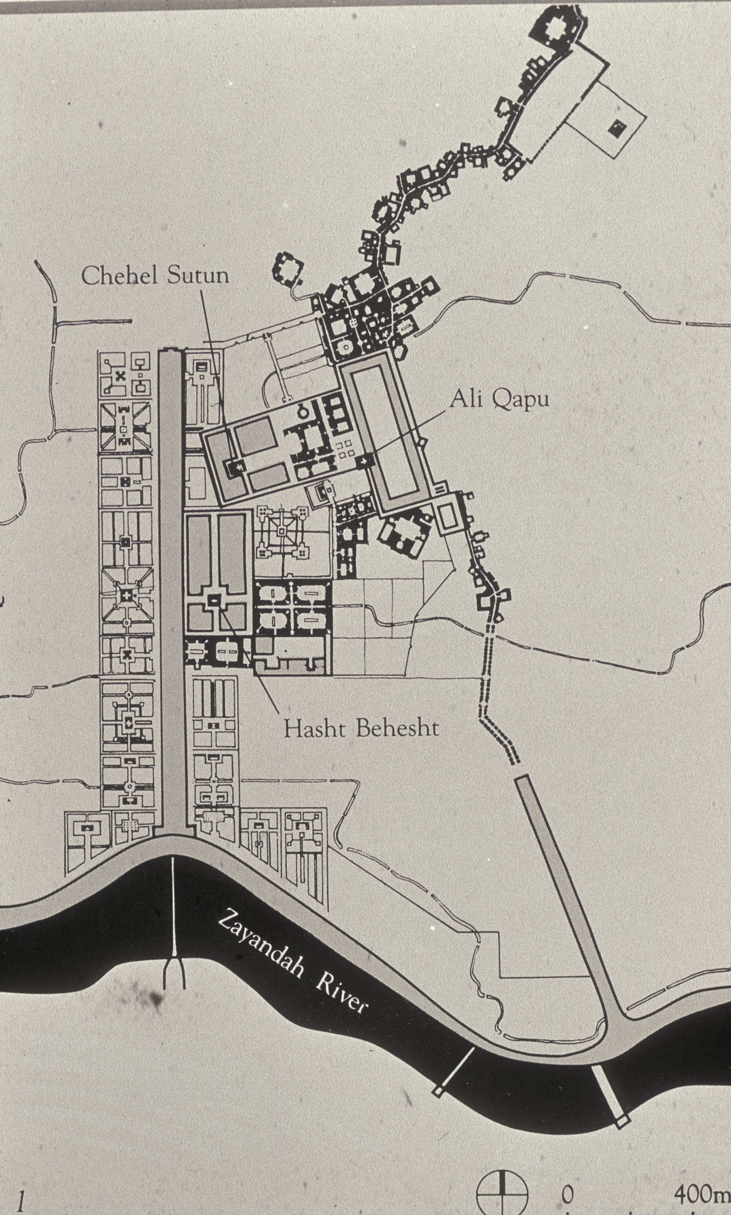

Slide 9
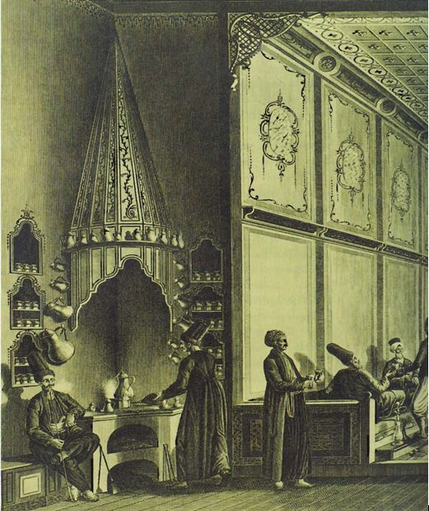
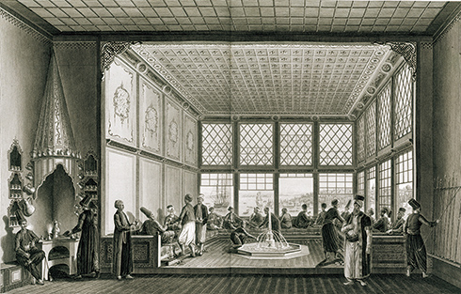
Antoine Ignace Melling 1763-1831 Coffeehouse, Istanbul

Slide 10
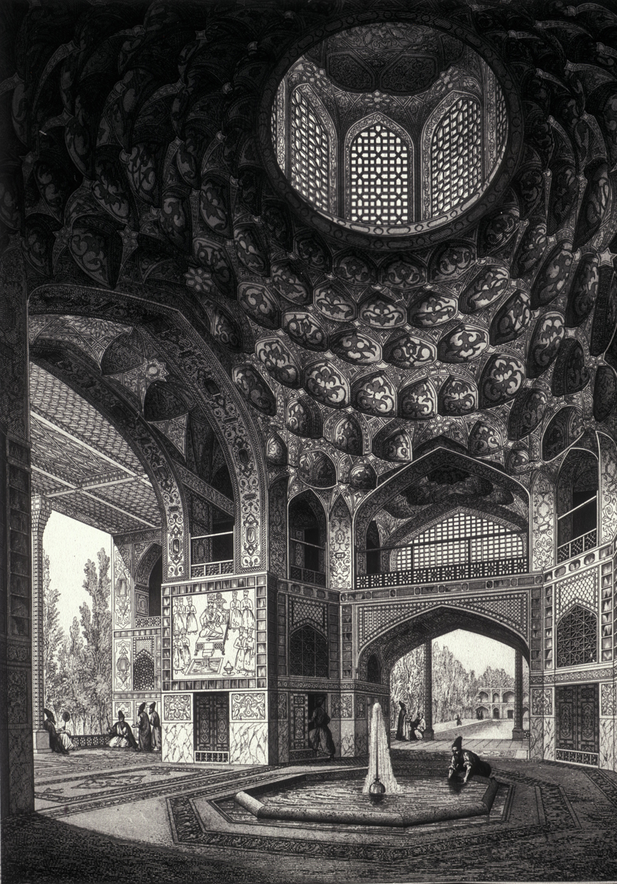
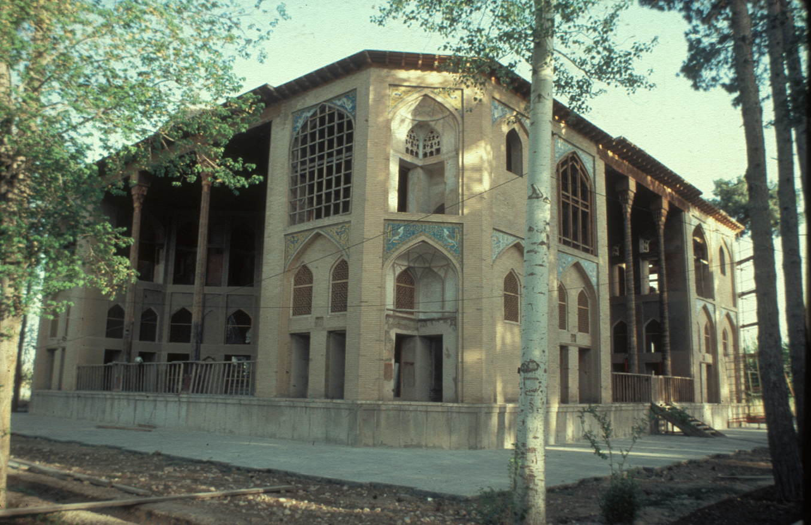
Hasht bihisht palace example of cross-axis type

Slide 11
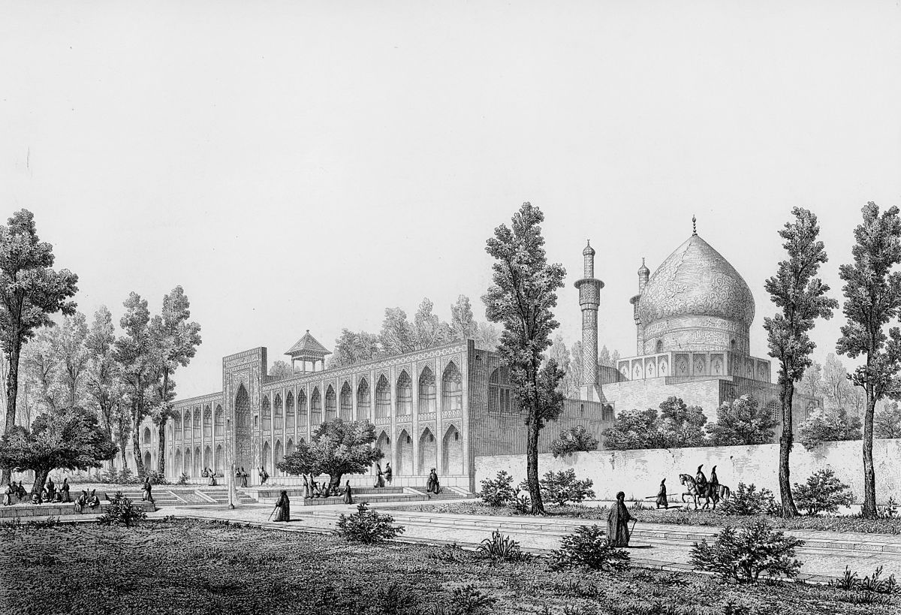
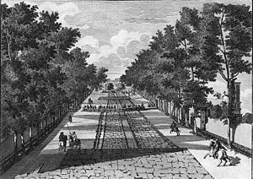
Chaharbagh and chaharbagh madrasa

Slide 12
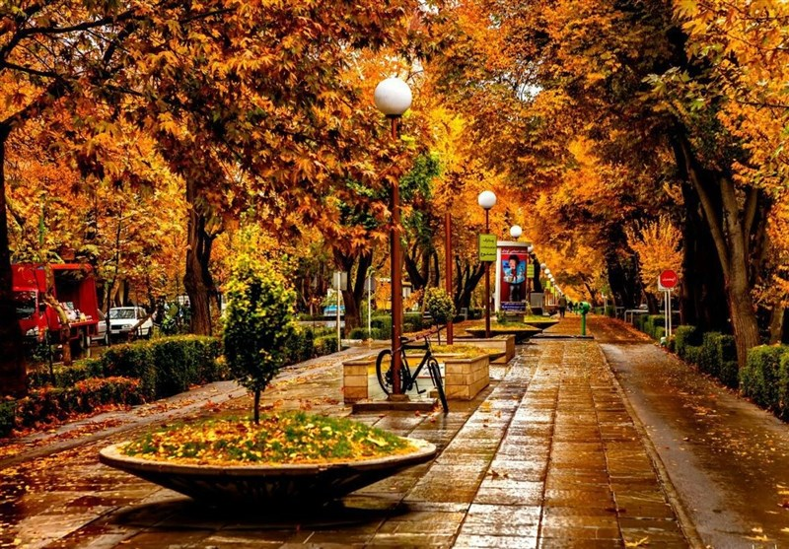
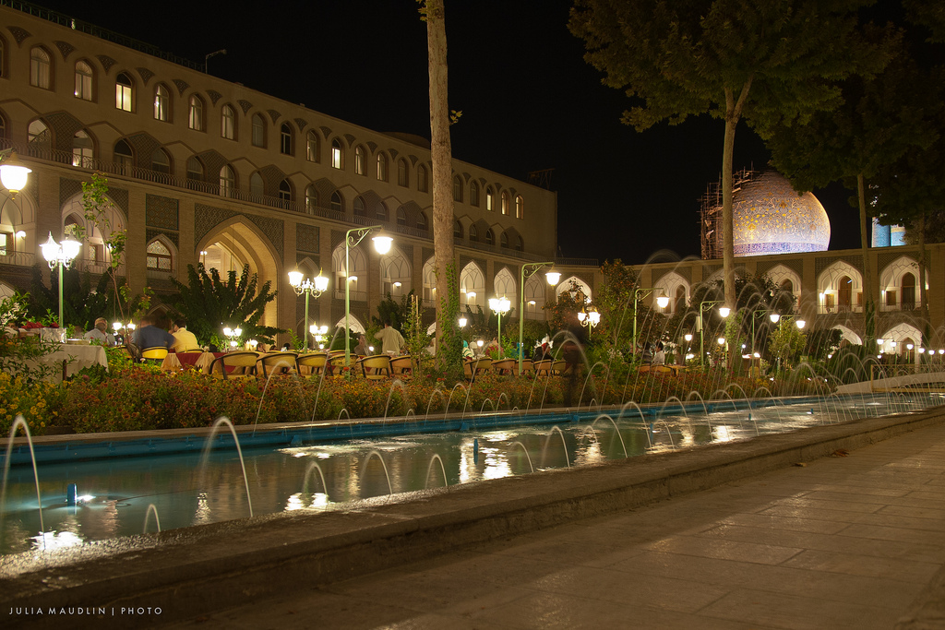

Slide 13
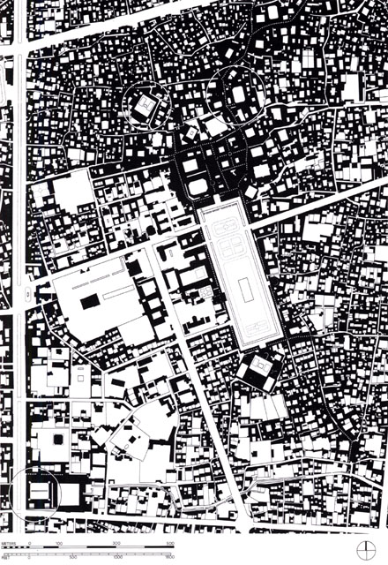
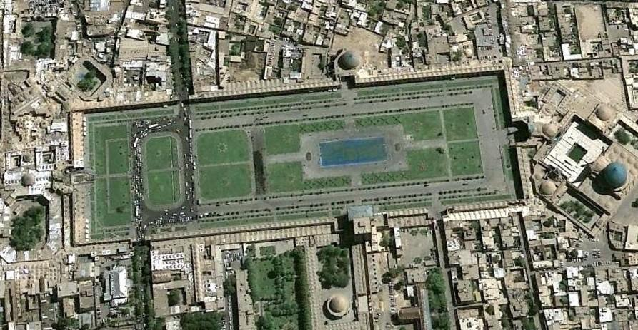
maydan

Slide 14
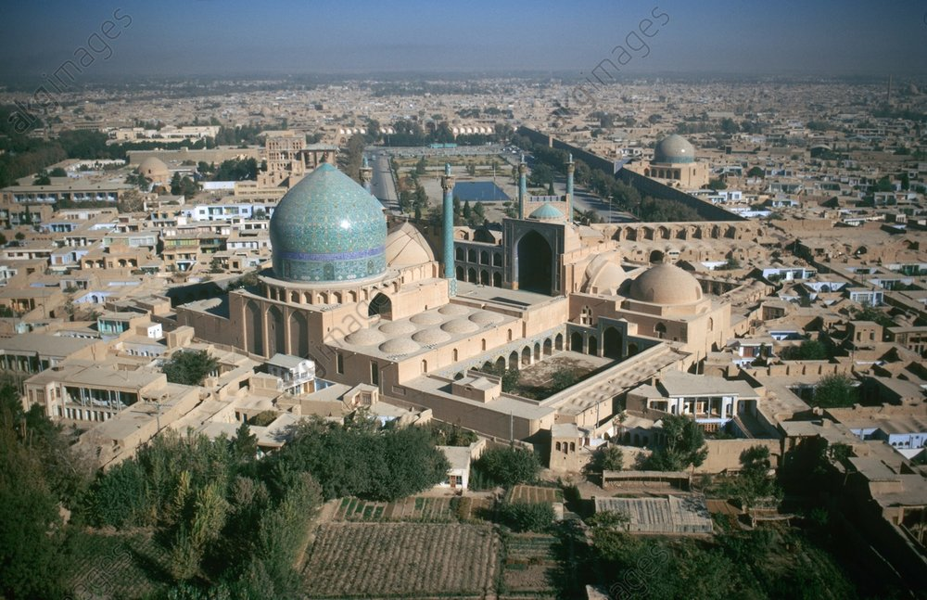

Slide 15
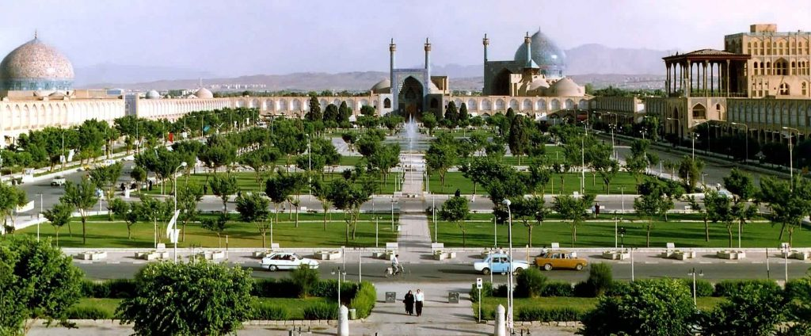

Slide 16
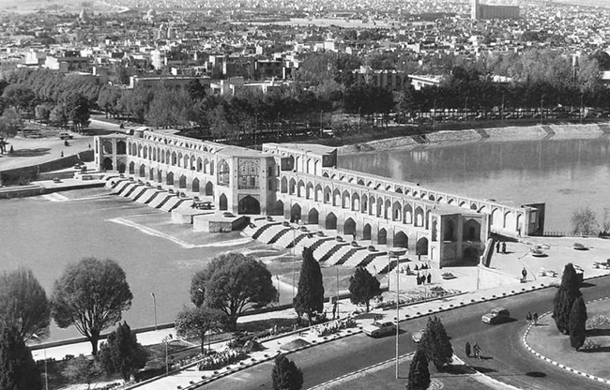
Kwaju bridge

